Slide 1
New Restaurant San Diego

Slide 2
Prospect Restaurant Locations
New restaurant owners might want to know the prospect locations for opening up new locations of their restaurant
Customers that want to know where new restaurants will be appearing sothey can eat there.

Slide 3
Data Acquisition & Cleaning
Zillow API for gathering all the neighborhoods within San Diego Metro area:
https://public.opendatasoft.com/api/records/1.0/search/?dataset=zillow-neighborhoods&rows=200&facet=state&facet=county&facet=city&facet=name&refine.state=CA&refine.county=San+Diego
Foursquare Datasets for existing restaurant information for neighborhoods within the San Diego Metroarea:
https://api.foursquare.com/v2/venues/explore?&client_id=UUTW1SJMSRNAECWRGCB2YATUROPNRT3KZMBCDUEGMNRT2KAA&client_secret=QQFYX4G5WB4NUXCKXVV3MY3DLOVOO2IEYNNYIDPACJO514PF&v=20200311&ll= 32.7157, 117.1611 &radius=500&limit=100

Slide 4
Feature Selection

Slide 5
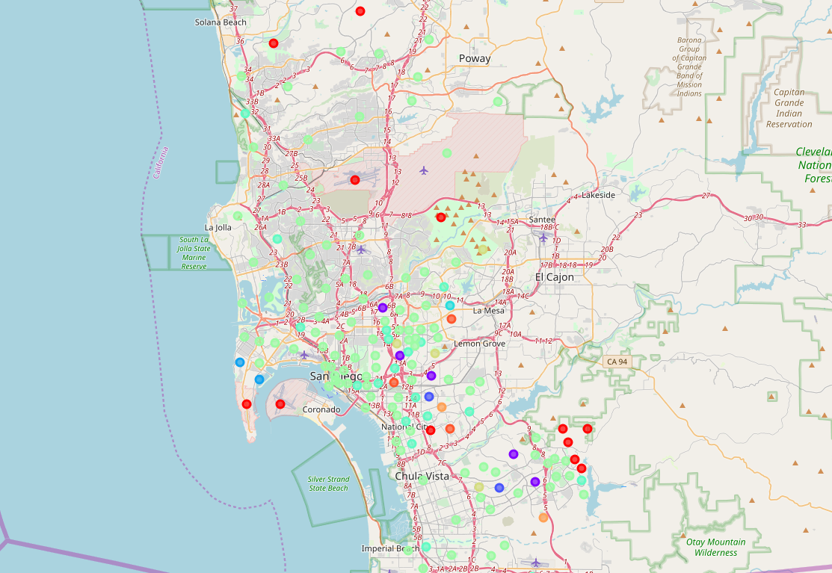
Cluster Neighborhoods

Slide 6
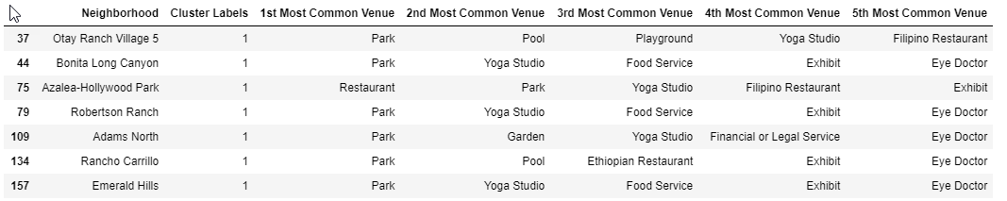
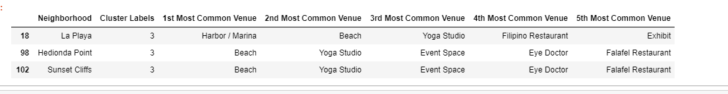
Prospective Neighborhoods

Slide 7
Conclusions
In this study, I analyzed the relationship between Venues in the Neighborhoods and their data.
I identified the Neighborhoods with most competition and least competition and neighborhoods that are in the need for restaurant type establishments.
Clusters 1 and 3 neighborhoods are the best for opening a new restaurant.
Within these areas there are few restaurants, but more recreational type venues where people gather and migrate to.

